Slide 1

Module I:
International Standardization
Introduction and Overview

Slide 2
Module I: Learning Objectives
This module provides a general overview of international standardization, including:
  Definition of basic terms and concepts
  An overview of the benefits of participation in international standardization
  An introduction to the:
    Role of the U.S. National Committee of the International Electrotechnical Commission (USNC/IEC)
    Key international standards organizations
    Key regional standards organizations

Slide 3
Module I: Disclaimer
The information contained in this self-taught
learning module is intended as a summary of documents and procedures frequently used within the IEC and the USNC/IEC.
For additional information about content addressed in this module, please contact the USNC/IEC Staff (usnc@ansi.org).
Additional information is also available via ANSI Education and Training Services.

Slide 4
Reference Materials &
Source Documents
ISO/IEC Directives, Part 1: 2017
Procedures for the technical work
ISO/IEC Directives, Part 2: 2016
Rules for the structure and drafting of International Standards
ISO/IEC Directives, Part 1:2017 + IEC Supplement:2017
Procedures specific to IEC
IEC Statutes and Rules of Procedures
IEC membership and participation procedures
USNC Statutes and Rules of Procedure: 2005
Model Operating Procedures for USNC/IEC TAGS: 2014
Guide for U.S. Delegates to meetings of ISO and the IEC

Slide 5
Standardization is a global activity encompassing a myriad of interests
Standards Developers and Conformity Assessment Bodies
Commercial Interests
Government Interests
Consumers, Educational Institutions, and General Interests

Slide 6
One Standard, One Test,
Accepted Everywhere
Accepted Everywhere
One Test
One Standard
In a global marketplace, the objective of the standardization process must be a single, technically valid and globally relevant standard with a single test of conformance to that standard. This will allow products to be distributed for worldwide commerce without change or modification.

Slide 7
Definitions
Standards
  Formal technical documents for generally accepted products, procedures, and policies
Standardization
  Use of common products, processes, procedures, and policies to facilitate attainment of business objectives
Conformity Assessment
  A process whereby a product, process, service, or system is evaluated against a standard

Slide 8
Definitions (cont.)
Consensus
  General agreement, characterized by the absence of sustained opposition to substantial issues by any important part of the concerned interests and by a process that involves seeking to take into account the views of all parties concerned and to reconcile any conflicting arguments.
  Source: ISO/IEC Guide 2
  IMPORTANT NOTE: Consensus does not imply unanimity

Slide 9

“Standards and technical regulations affect over 80 percent of global commodity trade”
Source: Benjamin H. Wu, Asst. Secretary for Technology Policy, U.S. Department of Commerce Testimony before the U.S. House of Representatives, Committee on Government Reform, May 13, 2005

Slide 10

Did you know…
In accordance with the World Trade Organization’s Technical Barriers
to Trade Agreement, International Standards are:
  developed within procedures intended to ensure global consensus
  developed and applied on a voluntary basis, but are increasingly adopted or referenced by governmental bodies
These standards shall be globally relevant and not “give preference to characteristics or requirements of specific countries or regions when different needs or interests exist in other countries or regions.”
The World Trade Organization (WTO) fosters international trade based on, among others, conformity assessment practices that balance regulated public protection and heightened industrial competition.

Slide 11

Q: Why should one participate in the development of international standards?
To facilitate the adoption of globally-accepted standards that will promote interoperability and commercial acceptance across the electrotechnical industry
To gain access to international markets; promote the protection of consumers by improving safety and health standards in the electrotechnical industry; safeguard the environment
To anticipate emerging standards and their impact on technology and global markets

Slide 12

Q: Why should one participate in the development of international standards? (cont)
Standards are strategic business tools
which help develop new global markets for electrical and electro-technology-related products and services.
U.S. participation helps ensure international market access to U.S. technology and helps to eliminate non-tariff trade barriers.
International standards are frequently adopted as, or used as the basis for, national and regional electrotechnical standards.
Participation keeps one on the cutting edge of current technology and market trends.

Slide 13
But where?
International Telecommunications Union
International Organization
for Standardization
International Electrotechnical Commission

Slide 14
The Big Three
International Telecommunications Union:
The purpose of ITU (founded in 1865) is to promote international cooperation on all questions of standardization in the fields of telecommunications and
radio communications.
International Organization for Standardization:
The purpose of ISO (founded in 1947) is to facilitate the internationalization and unification of standards and related activities over almost the entire range of technology (except that covered by IEC).
International Electrotechnical Commission:
IEC was founded in 1906 to promote international cooperation on all questions of standardization in the fields of electricity, electronics and related technologies.

Slide 15
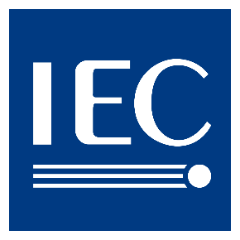
International Electrotechnical
Commission
The International Electrotechnical Commission (IEC),
based in Geneva, Switzerland, is a global non-
governmental organization that prepares and publishes international standards for all electrical, electronic and related technologies.
Through its members, which are known as “National Committees”, the IEC promotes international cooperation on all questions of electrotechnical standardization and related matters, including the assessment of conformity to standards.

Slide 16

International Organization for
Standardization
The IEC’s sister organization, ISO, is a non-
governmental organization and network of the national standards bodies of countries, one member per country, with a Central Secretariat in Geneva, Switzerland, that coordinates the system.
ISO acts as a bridging organization in which a consensus can be reached on standards and conformity assessment solutions that meet both the requirements of business and the broader needs of society, such as the needs of stakeholder groups like consumers and users.

Slide 17

International
Telecommunications Union
ITU is a world-wide organization which brings
governments and industry together to coordinate the establishment and operation of global telecommunication networks and services.
ITU is responsible for standardization, coordination and development of international telecommunications including radio communications, as well as the harmonization of national policies.
The ITU differs from ISO and IEC in that it was founded on the principle of cooperation between governments and the private sector.

Slide 18
Guiding Principles of
International Standards
International standards should meet societal and market needs and should not be developed to act as barriers to trade
ISO and IEC follow globally accepted principles of standards development:
  Transparency
  Openness
  Impartiality
  Effectiveness and relevance
  Consensus
  Performance-Based
  Coherence
  Due Process
  Technical Assistance

Slide 19
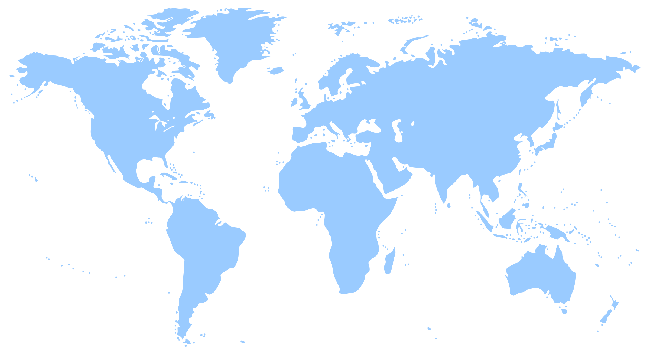
National Committees
Participating in the IEC
Canada
(SCC)
UK
(BSI)
Germany
(DIN/VDE)
U.S. National Committee
(USNC)
France
(AFNOR /UTE)
Japan
(JISC)
China
(SAC)
Brazil
(COBEI)
Australia
(SAA)

Slide 20
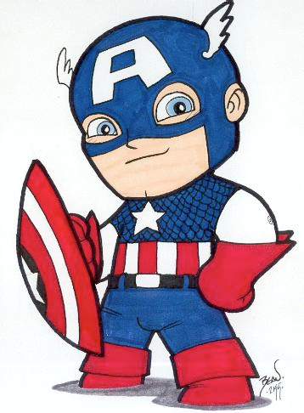
U.S. National Committee of the IEC
The U.S. National Committee of the
International Electrotechnical Commission (USNC/IEC) is a committee of the American
National Standards Institute (ANSI).
The USNC serves as the official U.S. member of the IEC and represents and coordinates the U.S. involvement in electrotechnical bodies associated with the IEC on behalf of ANSI.

Slide 21
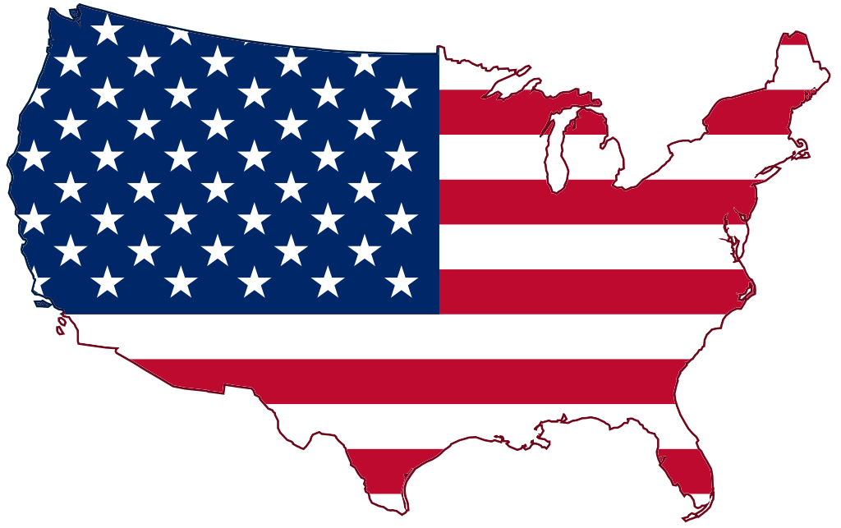
U.S. National Committee of the IEC:
Guiding Principles
governance
administration
management
guidance
authority
diplomacy
influence

Slide 22



USNC/IEC’s Mission
The USNC/IEC mission is to provide strategy to effectively participate in the development of IEC standards to facilitate international trade for the benefit of the U.S. industry in the fields of all electro-technologies, and to provide a framework to the U.S. industry which serves as the focal point, conduit and advocate for U.S. interests in international and regional electrotechnical standards, conformity assessment, and other related matters.

Slide 23

U.S. National Committee of the IEC
Represents the U.S. in the development, promulgation and use of globally-relevant standards for the electro-technical industry
Engages in the assessment of conformance to standards such as testing, certification and accreditation
Serves as a conduit to the global standards-setting community
Is a totally integrated committee of the American National Standards Institute (ANSI)
  ANSI provides administrative support to the USNC

Slide 24
USNC/IEC’s Scope of Work
Electrotechnologies
  Electronics
  Magnetics and electromagnetics
  Electroacoustics
  Multimedia
  Telecommunication
  Energy production and distribution
Associated general disciplines
  Terminology and symbols
  Electromagnetic compatibility
  Measurement and performance
  Dependability, design and development
  Safety and the environment

Slide 25

Regional Standards Organizations
European Standards
Organizations
(CEN)
(CENELEC)
(ETSI)
The Americas
(CANENA)
(COPANT)
Pacific
Rim
(FINCA)
(PASC)
(APCF)

Slide 26

Importance of global cooperation and collaboration
Active participation in both international and regional standards-setting activities provides U.S. electrotechnical industry experts
with. . .
  The ability to influence domestic and international policy
  A chance to benefit from unique networking opportunities and exchange experiences with international colleagues
  A forum for the presentation of the U.S. industry positions
  Opportunity to comment upon proposals submitted by others
  Ability to work actively and multilaterally towards the abolishment of technical barriers to trade and expand U.S. access to international markets

Slide 27
Join Us!
The USNC operates over 160 IEC Technical Advisory Groups (TAGs)
Over 2,000 experts are currently involved in TAG activities in the U.S.
Every year hundreds of U.S. experts participate in international IEC Technical Committee meetings, directly affecting the development of international standards
Get involved!!! Contact the USNC staff to learn how to join a TAG and make a difference (usnc@ansi.org).

Slide 28
Internet Resources
International
IEC – International Electrotechnical Commission
ISO – International Organization for Standardization
United States
USNC – United States National Committee
of the IEC
ANSI – American National Standards Institute

Slide 29
Internet Resources (cont)
Regional
CANENA - Council for Harmonization of Electrotechnical Standards of the Nations of the Americas
COPANT - Pan American Standards Commission
FINCA - Forum of IEC National Committees of the Americas
CENELEC - European Committee for Electrotechnical Standardization
ETSI - European Telecommunications Standards Institute
PASC - Pacific Area Standards Congress
APCF - Asia-Pacific Regional Centre

Slide 30
Further Training Activities
The USNC holds Instructor-Led Training Courses throughout the year. Contact the USNC staff (usnc@ansi.org) to find out when and where the next one is taking place.

Slide 31
USNC Constituent Training Program
Module I
Complete

Slide 33
Backup Information on Regional Organizations

Slide 34



Regional Standards Bodies
Pacific Area Standards Congress (PASC)
  Countries of the Pacific Rim
  Does not set standards, rather coordinates on standards issues
Pan American Standards Commission (COPANT)
  Promulgates the development of technical standards and related activities in its member countries (Canada, U.S., Mexico, countries of Central and South America)
  Promotes industrial, scientific and technological development in support of trade in goods and services
  Facilitates cooperation in intellectual, scientific and social fields
Council for Harmonization of Electrotechnical Standards of the Nations of the Americas
  Fosters harmonization of electrotechnical product standards, conformity assessment test requirements, and electrical codes between all countries of the Western Hemisphere

Slide 35

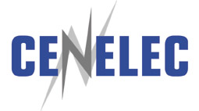

Standardization Bodies of the EU
European Committee for Standardization
  Harmonizes technical standardization except electrotechnical and telecommunications
European Committee for Electrotechnical Standardization
  Harmonizes all areas of standardization and conformity assessment in electrical, electronic and allied fields
European Telecommunications Standards Institute
  Sets telecommunications standards for Europe

Slide 36
Established in 1973 - based in Brussels
Composed of 28 EU and 3 EFTA countries
Harmonizes all areas of standardization and conformity assessment in electrical, electronic and allied fields
Scope of work is similar to that of IEC
  Approximately 70% of all CENELEC-approved standards are identical to IEC standards and another 15% are based upon IEC texts

Slide 37
The USNC is recognized as the primary U.S. liaison to CENELEC and can provide comments on draft standards
  ANSI is the U.S. liaison to CEN (ISO)
U.S. individuals may be granted access to CENELEC work via provisions of the Dresden Agreement
  CEN through provisions of the Vienna Agreement (ISO)

Slide 38

THE DRESDEN AGREEMENT for technical cooperation between IEC and CENELEC
  Goal is to ensure the equivalence (whenever possible) of IEC and European electrotechnical standards
  Guides coordination and harmonization of standards of the national committees of IEC and CENELEC
  Grants to IEC the “Right of First Refusal”
    CENELEC will first offer new work to IEC
    If IEC accepts the project, CENELEC will cease working on the project within Europe
  Became effective September 1996
    Supersedes the Lugano Agreement of 1991
Notes:
Like the Vienna Agreement, the Dresden Agreement provides for the exchange of information and allows for mutual representation between CENELEC & IEC Technical Committees and Subcommittees
Grants to IEC the “Right of First Refusal”
CENELEC will first offer new work to IEC
If IEC accepts the project, CENELEC will cease working on the project within Europe
CENELEC initiates development work only in those areas where international work is not expected to be successful in a reasonable timeframe due to
Technical differences
Legislative differences
Commercial differences
NOTE 1: CENELEC national member bodies, with the exception of Luxembourg and Iceland, are also members of IEC.
NOTE 2: Most IEC projects are automatically considered for adoption as CENELEC standards.

